Slide 1

Welcome to
Building Product Division
Product Presentation

Slide 2
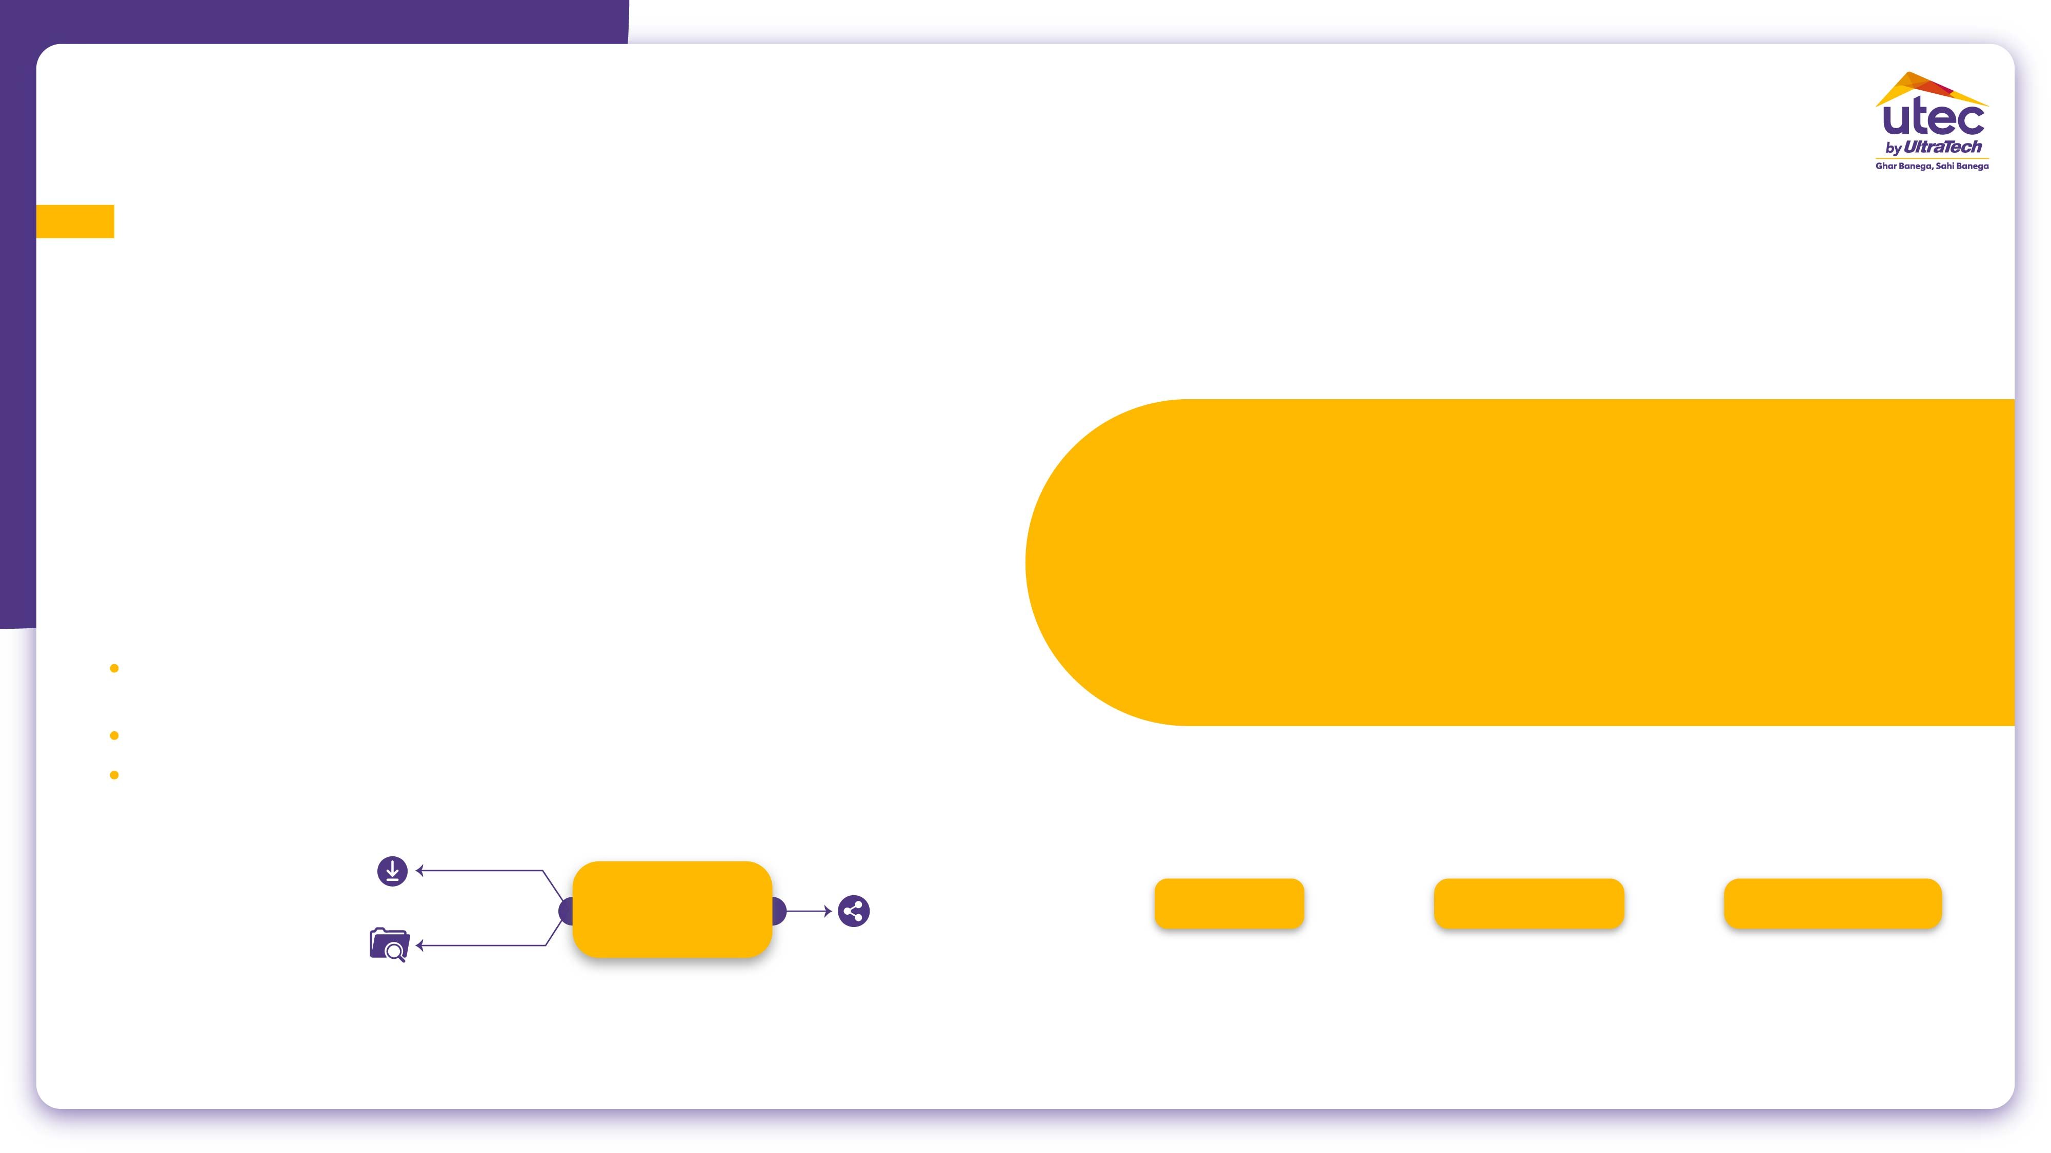
Solutions from UltraTech Building Products Division
Assured & consistent Quality
Products from trusted brand - UTCL
Stage wise
Technical Support
Water saving
Complies with standards
Speedy – work
Site trainings and live testing
MTC With each supply
Standard mix proportions
Superiority in Technical attributes
Higher coverage
Superior adhesion strength
Crack resistance
Water proofing – clearly defined
More yield
Ready to use
High Pot life/ Open time
Nil slip/ sagging
Injection grouts
Value for money in each sqft

Slide 3






Green Building Criteria
Saving in Time.
Saving in Labour.
Saving in Water.
Ready to Use items.
Quality raw material for construction.
Durability and sustainability.
Waterproofing is the process of making an object or structure waterproof or water-resistant so that it remains relatively unaffected by water or resisting the ingress of water under specified conditions.

Slide 4
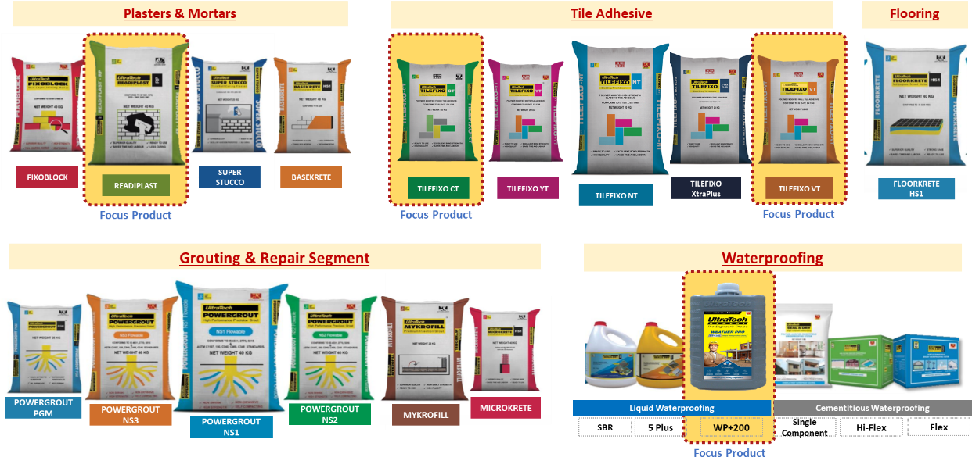
Product Categories: Dry Mix Mortars & Waterproofing

Slide 5
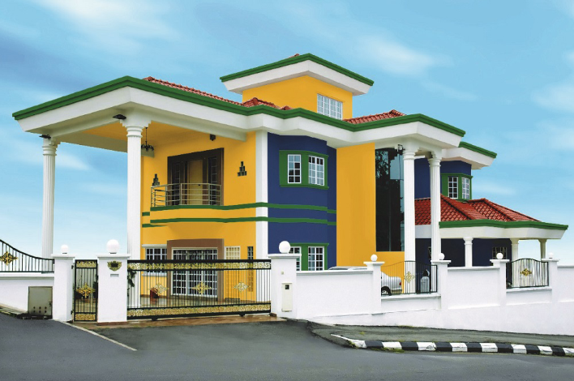
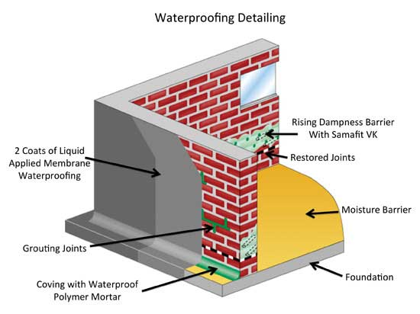
Water proofing Solutions for areas in a building
Bathrooms
Kitchen
Balconies
Terrace or roofs
Water tanks
Swimming pools
Waterproofing is the process of making an object or structure waterproof or water-resistant so that it remains relatively unaffected by water or resisting the ingress of water under specified conditions.

Slide 6
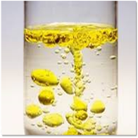
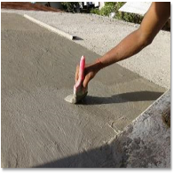
Methods of Waterproofing of New Building
Membrane
Water Proofing
Integral Water Proofing
Waterproofing is the process of making an object or structure waterproof or water-resistant so that it remains relatively unaffected by water or resisting the ingress of water under specified conditions.

Slide 7
UltraTech Waterproofing Product Solution

Slide 8
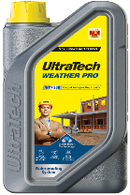
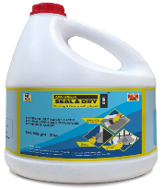
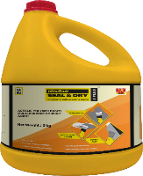
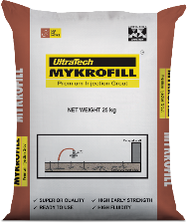
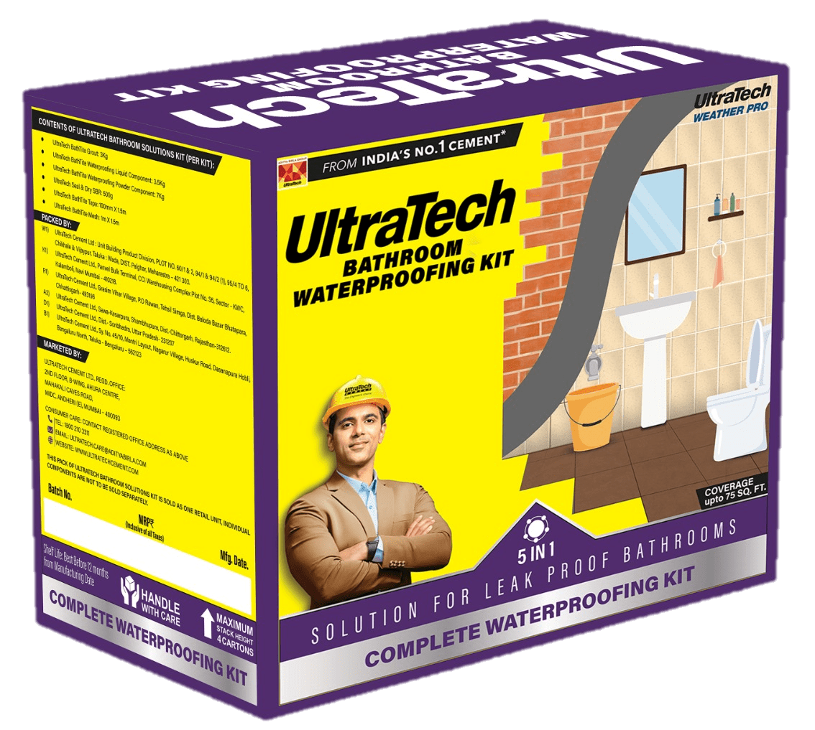
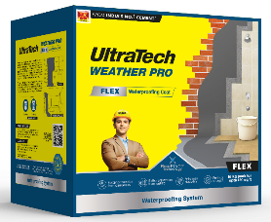
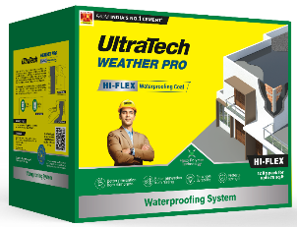
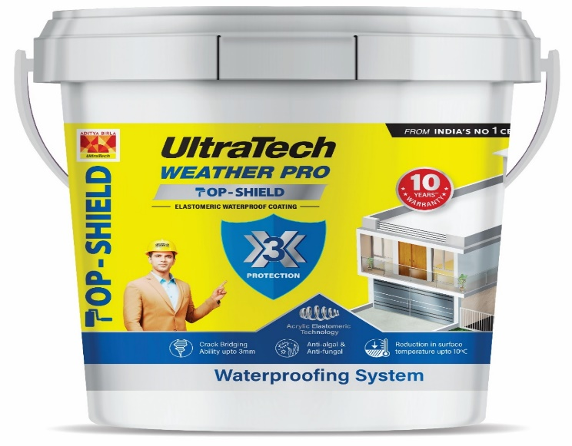
UltraTech WeatherPro – WP+200
Integral Waterproofing Compound
UltraTech Seal&Dry –
SBR
Bonding & Waterproofing Agent
UltraTech Seal&Dry –
5PLUS
Bonding & Waterproofing Agent
UltraTech Seal&Dry –
MYKROFILL
Premium Injection Grout
Waterproofing is the process of making an object or structure waterproof or water-resistant so that it remains relatively unaffected by water or resisting the ingress of water under specified conditions.
UltraTech WeatherPro – Top Shield
Single component Waterproofing System
UltraTech
Bathroom Waterproofing Kit
UltraTech WeatherPro - FLEX
Two Component Waterproofing System
UltraTech WeatherPro – Hi-FLEX
Two Component Waterproofing System

Slide 9
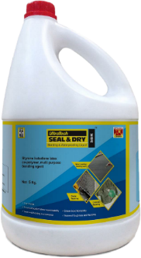
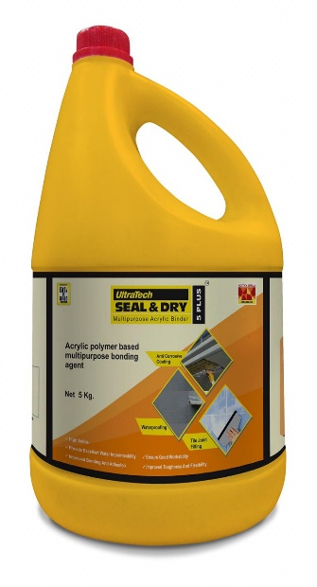
Liquid Waterproofing
Cementitious Waterproofing
Brand
Seal & Dry SBR
Seal & Dry 5 Plus
WeatherPro WP+200
Mykrofill
Seal & Dry Flex
Seal & Dry Hi-Flex
Product
Styrene Butadiene Latex co-polymer, multipurpose bonding agent
Acrylic polymer based multi purpose bonding agent
Integral Waterproofing… to be mixed with Plaster/ Concrete at time of construction
Cementitious Premium injection grout
Two Component Cementitious Waterproofing
Two Component Cementitious Waterproofing
Waterproofing is the process of making an object or structure waterproof or water-resistant so that it remains relatively unaffected by water or resisting the ingress of water under specified conditions.
Application
Modifier for concrete & Mortar in repair work
Anti-corrosive protection, Priming coat over plaster & General w/p
Mix with Plaster/ Concrete at time of construction
Pressure grouting in concrete
Sloping roofs, balconies, RCC water tanks, etc for areas <10,000 sq.ft
Terrace, domes, swimming pools, sump tanks, etc for area >10,000sq.ft

Slide 10
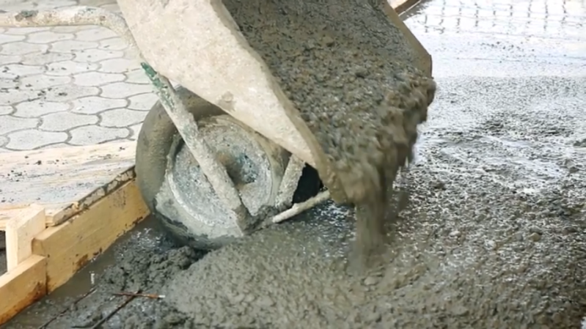
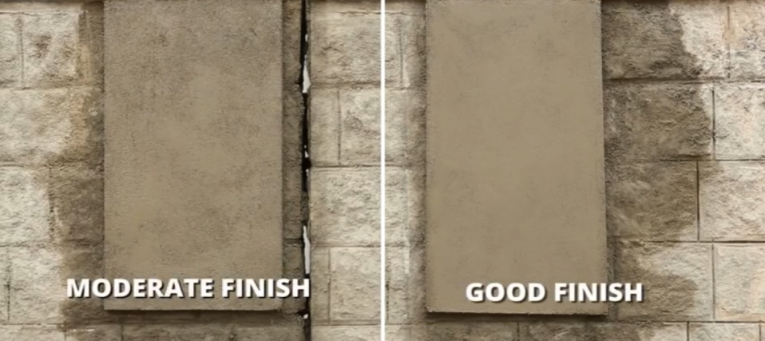
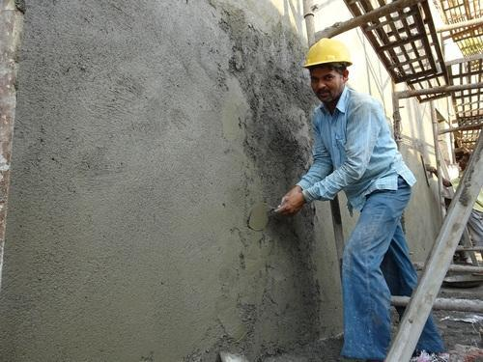
Integral Waterproofing Liquid - UltraTech WeatherPro WP+200
WeatherProWP+200 is an Integral Waterproofing Liquid.
Technical Parameter complies with IS 2645 & IS 9103
Dosage -200 ml WeatherPro WP+200 per 50 KG Cement
Features :
Reduces water cement ratio
Improves workability
Very easy to mix
Reduces permeability
Produces dense homogenous mixes
Enhances the compressive strength
Area of Applications :
Used for increasing the workability, density of concrete and mortars
Used for all types of site – mixed normal concreting, for external and internal plastering
It can be also used for brick jointing works and also in the repair concrete and mortar work applications.
Site concrete mix with Weather Pro WP+200
SKU : 1, 5, 10, 20, 50 Lts
Waterproofing is the process of making an object or structure waterproof or water-resistant so that it remains relatively unaffected by water or resisting the ingress of water under specified conditions.
Without Weatherpro WP+200
With WeatherPro WP+200
External plaster with WeatherPro WP+200

Slide 11
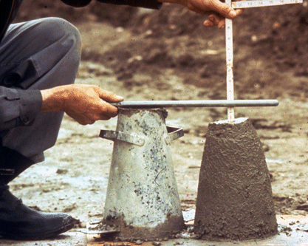
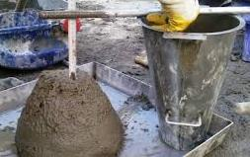
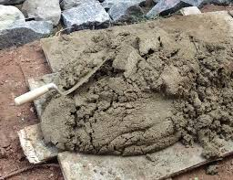
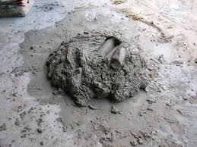
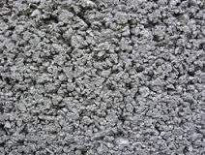
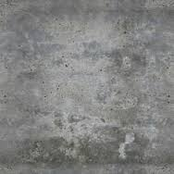
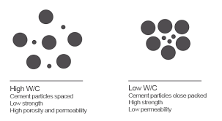
UltraTech Weather Pro WP+ Usages
WORKABILITY
COHESIVENESS
Without Weather Pro WP+
With Weather Pro WP+
Without Weather Pro WP+
With Weather Pro WP+
HONEY COMBING
W/C RATIO
Waterproofing is the process of making an object or structure waterproof or water-resistant so that it remains relatively unaffected by water or resisting the ingress of water under specified conditions.
High W/C
Cement particles spaced away
Low Strength High Porosity
Low W/C
Cement particles closely packed High Strength Low Porosity
Without Weather Pro WP+
No Honeycombing With Weather Pro WP+

Slide 12
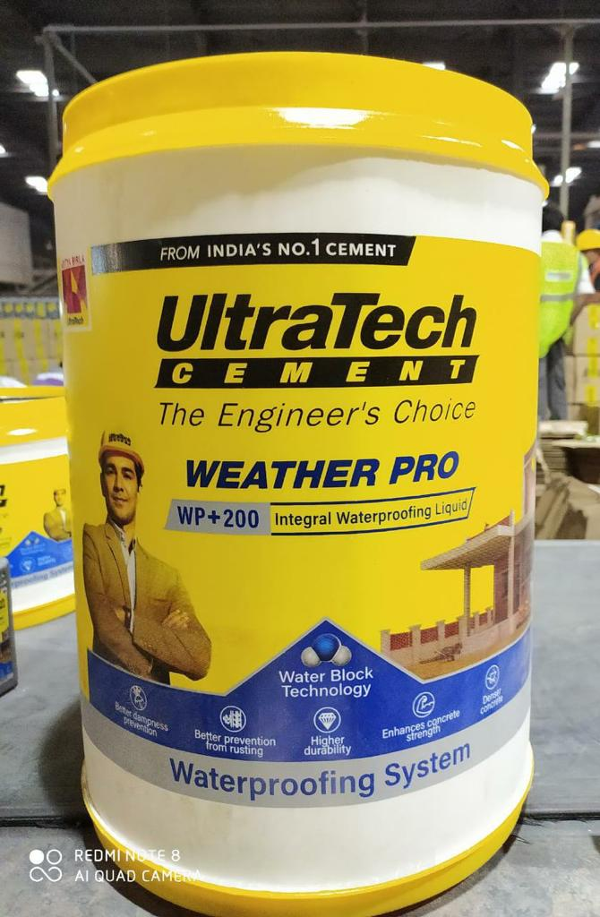
UltraTech Weather Pro WP+ Usages
If capillary system in the concrete / mortar is broken, that will hinder rising of the water through these capillaries which will control dampness
Thus need to use an additive which not only break the capillaries but also improve the workability of concrete / mortar by reducing the demand of water
Discontinuity of Pore Tract Ensures No Moisture Migration Within Concrete Mass
Solution
Waterproofing is the process of making an object or structure waterproof or water-resistant so that it remains relatively unaffected by water or resisting the ingress of water under specified conditions.
Adding WeatherPro WP+
12

Slide 13
UltraTech SEAL & DRY – SBR
Features and Benefits
Easy and simple to use
Excellent repair material
Strongly bonds old and new plaster/concrete surfaces
Has higher coverage and tackiness time
Following are the usages of SBR with mix ratio and coverage :
Description | Bonding Agent (SBR:C) | Water Proofing | Polymer Modified Mortar | Polymer Modified Concrete | Polymer Modified Plaster
 |  | (SBR:W:C)
Mix Ratio | 1 : 1 | 1 : 1 : 2 | 3 – 3.5 Kg per 50 kg bag of cement | 1.5 – 2 Kg per 50 kg bag of cement | 750 gm - 1 Kg per 50 kg bag of cement
Coverage | 45 – 48 Sq. ft. | 100 Sq. ft. @1 mm thickness in 2 coats | Depends on mortar mix preparation | Depends on concrete mix proportion | Depends on plaster mix proportion
Waterproofing is the process of making an object or structure waterproof or water-resistant so that it remains relatively unaffected by water or resisting the ingress of water under specified conditions.

Slide 14
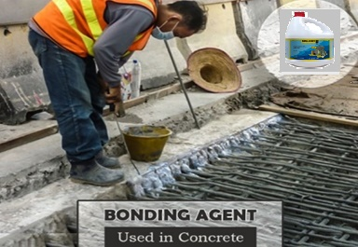
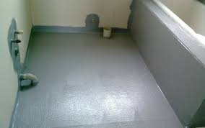
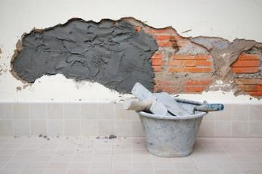
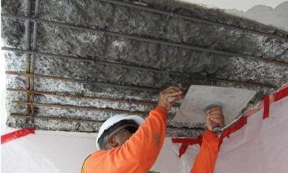
UltraTech SEAL & DRY SBR – Application Areas
Old Concrete to New Concrete-Bonding Agent
Waterproofing for Small Areas
Waterproofing is the process of making an object or structure waterproof or water-resistant so that it remains relatively unaffected by water or resisting the ingress of water under specified conditions.
Patch Repair Works
Bonding Agent- During Plastering

Slide 15
SEAL & DRY – 5 PLUS
Features and Benefits
Cover Pin Holes
Excellent Volumetric Stability
Excellent material for repair & renovation
Corrosion resistant
10 % higher Compressive strength
Description | Bonding Agent | Polymer Modified Plaster | Polymer Modified Concrete | Polymer Modified Mortar | Anti Corrosive Rebar Coating | Crack Filling | Priming/ Key Coat (5 Plus :W:C)
Ratio | 1:1 | 750 gm - 1 Kg per 50 kg bag of cement | 1.5 – 2 Kg per 50 kg bag of cement | 3 – 3.5 Kg per 50 kg bag of cement | 1 : 1.5 | 1 : 2 | 2 : 1 : 1
Coverage | 45 - 48 Sq. ft. | Depends on plaster mix proportion | Depends on concrete mix proportion | Depends on mortar mix preparation | 75 RMT @1 mm thickness for 10 mm dia bar | 85 RMT @6mm X 6 mm "V" Groove | 75 Sq. ft.
Waterproofing is the process of making an object or structure waterproof or water-resistant so that it remains relatively unaffected by water or resisting the ingress of water under specified conditions.

Slide 16
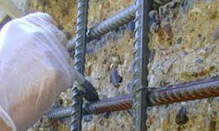
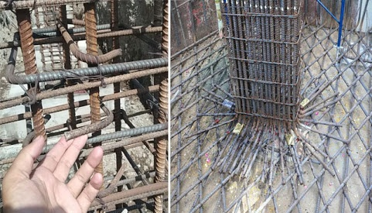
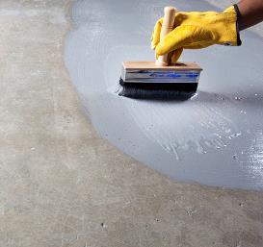
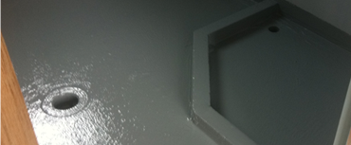
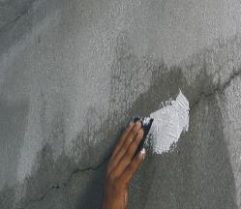
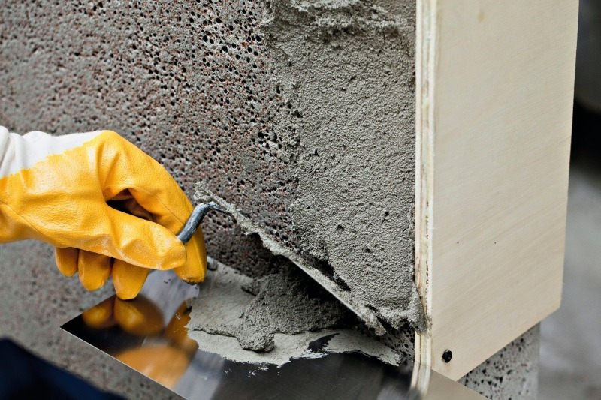
UltraTech SEAL & DRY 5 Plus – Application Areas
Anticorrosive Coating – Steel Bars
Key Coat/ Prime Coat
Waterproofing for Smaller Areas
Waterproofing is the process of making an object or structure waterproof or water-resistant so that it remains relatively unaffected by water or resisting the ingress of water under specified conditions.
Treating Plastic Shrinkage Cracks
Modifier for Repair Plasters, Mortars, & Concrete

Slide 17
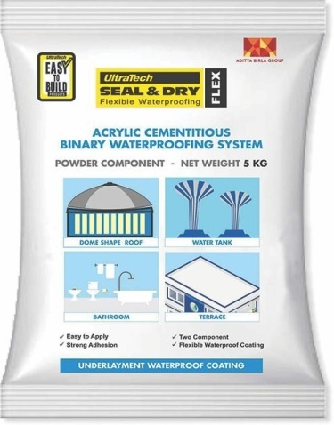
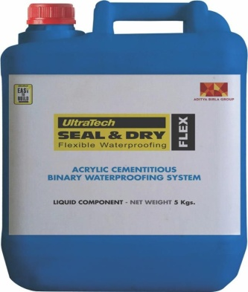
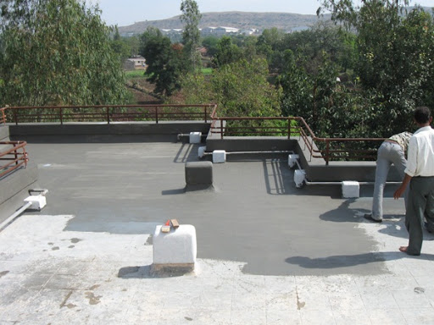
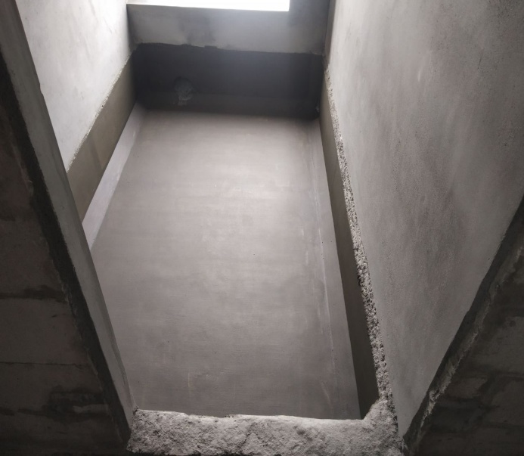
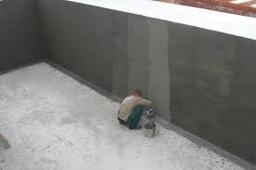
UltraTech Seal & Dry Flex
SEAL & DRY – FLEX: Two component, cement based, styrene acrylic polymer based flexible, waterproof coating for terrace, sloping roofs, RCC water tanks, balcony & domes and highly recommended for waterproofing of areas upto 2,000 sq.ft Elongation is 50 % at a tensile force of 50Kg/Sq.cm
Water resistance up to 5 bars water pressure @ 1 mm DFT.
SKU : 3, 15 Kg
Coverage – 7 – 8 Sq. ft. / Kg @1mm DFT @ 2 coats
BENEFIT
No water curing
Convenient to apply
Faster completion of work
Negligible wastage
Strong Adhesion
Non Toxic
Waterproofing is the process of making an object or structure waterproof or water-resistant so that it remains relatively unaffected by water or resisting the ingress of water under specified conditions.

Slide 18
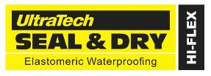
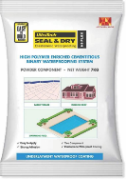
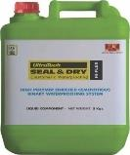
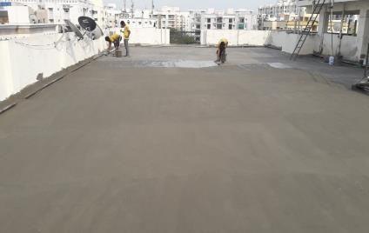
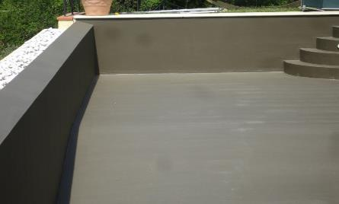
UltraTech Seal & Dry HI Flex
SEAL & DRY – HIFLEX: Two component, cement based, acrylic emulsion polymer based elastomeric, waterproof coating for terrace, slope roofs, balcony, domes, swimming pools, sump tanks, exterior walls of area up to 10,000sq.ft. Elongation is more than 100% at a tensile force of 50Kg/Sq.cm
Water resistance up to 5 bars water pressure @ 1 mm DFT.
SKU : 12, 24 Kg
Coverage – 5 – 6 Sq. ft. / Kg @1mm DFT @ 2 coats
BENEFIT
No water curing
Convenient to apply
Faster completion of work
Negligible wastage
Eco-friendly product.
Non Toxic
Waterproofing is the process of making an object or structure waterproof or water-resistant so that it remains relatively unaffected by water or resisting the ingress of water under specified conditions.

Slide 19
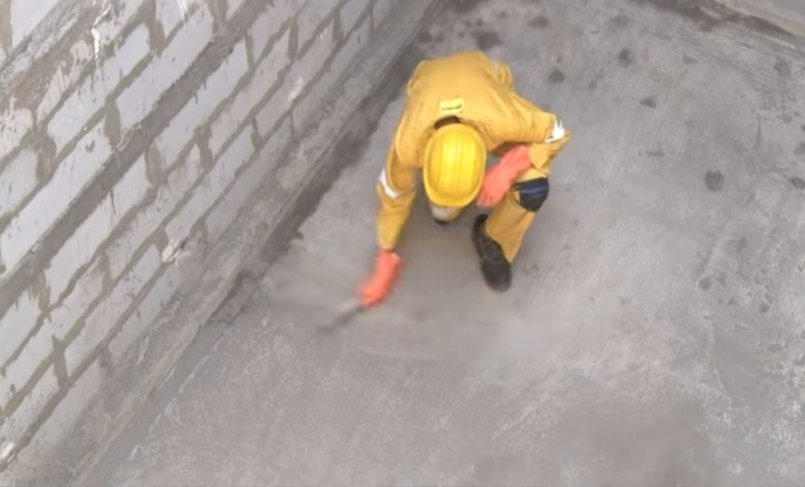
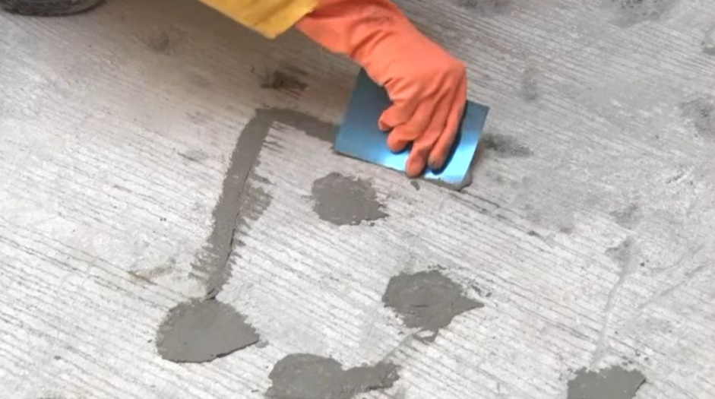
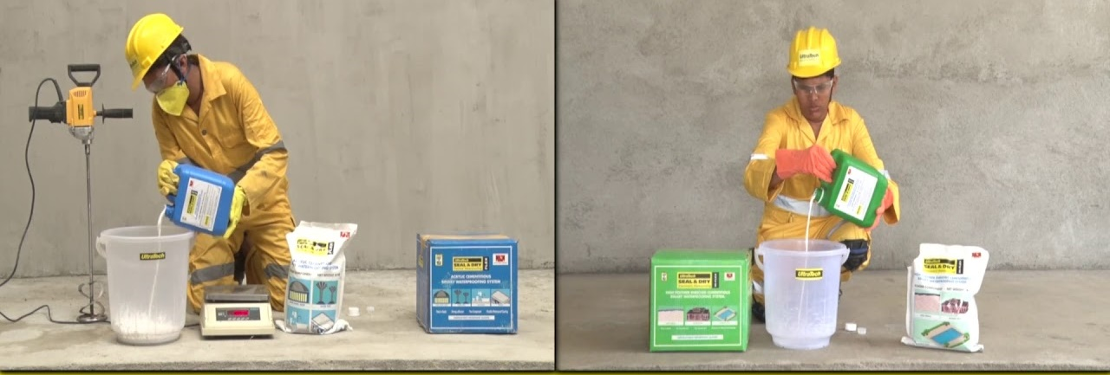



Steps for Waterproofing Application
Surface preparation & Cleaning
Crack Treatment
Mixing
Waterproofing is the process of making an object or structure waterproof or water-resistant so that it remains relatively unaffected by water or resisting the ingress of water under specified conditions.
Waterproofing Coatings
Post Ponding Test
Protection Screed

Slide 20

Liquid Applied Membranes – Acrylic Coatings
UltraTech
WEATHER PRO
TOP-SHIELD
(The coating for your roofs)

Slide 21
Benefits- UltraTech Weather Pro Top-Shield
Features & Benefits
Higher tensile, elongation properties with excellent bond strength to cementitious substrates
Excellent Crack bridging ability up to 3mm width
Water resistance up to 7 bar water pressure @1mm Dry Film Thickness (DFT)
Reduction in surface temperature of roofs up to 10°C with white shade as a top coat.
Resistant to foot traffic with excellent abrasion resistance.
The coating is UV resistant and provides higher resistance to long term weathering effects
Single component and easy to apply.
Can be applied directly on existing sound and cured concrete surfaces, Brick Bat Coba with IPS/screed even without removing.
No protection screed is required.
Dry film thickness of 1mm in three coat application
Excellent breathability ensuring escape of water vapour from the surface
Resistant to Algae and fungi growth
Excellent barrier against carbonation.

Slide 22







Pack Size & Shades
Pack Sizes
1L, 4L, 10L, 20L
Shipper Packs
8*1L
2*4L
10 & 20L buckets
Shades
WHITE GREY TERRACOTTA
Shelf Life & Storage conditions- 36 months.
Store the pack away from sunlight & in a well ventilated room.

Slide 23

UltraTech
New Generation Tile Adhesives

Slide 24





ISSUES FACED IN CONVENTIONAL FLOOR TILING
Slurry Dries quickly allowing less time for adjustability.
Uneven Spread leads to voids creating hollowness
Improper contact leads to de-bonding, frequent repairs, breaking of tiles, formation of stain, efflorescent etc.
Low time for tile adjustments leading to improper alignment & poor aesthetics.
Requires curing- Difficulties in curing leads to lower bond strength, shrinkage & de-bonding

Slide 25


Slide 26













X’TRA
PLUS
Tile Underlayment Mortar
Wall levelling Mortar

Slide 27













IS | EN
T1 | C1
IS | EN
T2 | C1
IS | EN
T3 | C2
IS | EN
T3 | C2
IS | EN
T4 | C2
TILEFOXO-CT
For Interior floor Ceramic tiles application of small format tiles
TILEFOXO-VT
For Vitrified Tiles – Wall and Floor application
TILEFOXO-NT
For Natural Stone fixing on walls and floors
TILEFOXO-YT
White Adhesive for white marbles and Italian marbles
TILEFOXO-X’traPlus
Heavy Duty tile adhesive for fixing large format tiles.
TILEFOXO-Grout
Cementitious & Epoxy
Tile Grout Filling
Water Powder Ratio:- 25 % by wt. of material /// Coverage for 20 Kg Bag :- 80 Sq. ft. @3 mm or 40 Sq. ft. @6 mm

Slide 28





Tile Adhesive
T1
For Interior / small format Ceramic tiles application
As per IS 15477 –
T1 Type – Tiles with porosity > 3%
Tile Adhesive
T2
For small to medium format Vitrified Tiles on Wall and Floor application
As per IS 15477 –
T2 Type – Tiles with porosity < 3%
Tile Adhesive
T3
For fixing Natural Stones / Granites on walls and floors
As per IS 15477 – T3 Type – Tiles with any porosity
Tile Adhesive
T3
White Adhesive for white marbles and Italian marbles
As per IS 15477 –
T3 Type – Tiles with any porosity
Tile Adhesive
T4
Heavy Duty tile adhesive for fixing large format tiles.
As per IS 15477 –
T4 Type – Tiles with any porosity

Slide 29


Different types of Tile Adhesive

Slide 30



NEW GENERATION TILE ADHESIVE - VT
TILEFIXO-VT :-
Premium Polymer modified tile
adhesives
Suitable for large format range
of Vitrified floor and wall application over concrete substrate
Applicable for Tile on tile over
substrate like ceramic, vitrified
and mosaic
Pack Size – 20 Kg
Colour – Grey & White
Shelf Life – 12 Month

Slide 31




NEW GENERATION TILE ADHESIVE - NT / X’traPlus
TILEFIXO-NT :-
High Strength Tile Adhesive
Specially designed for large size
natural stone like verities of Granite and other stones
For vertical and horizontal
application over concrete
and plastered surface
Pack Size – 20 Kg
Colour - Grey
Shelf Life – 12 Month

Slide 32



NEW GENERATION TILE ADHESIVE - YT
TILEFIXO-YT :-
Premium White cement based polymer modified Cementitious tile adhesives
Suitable for Italian and Indian marble Stone for substrate on concrete and over stone flooring
Pack Size – 20 Kg
Colour - White
Shelf Life – 12 Month

Slide 33

NEW GENERATION TILE ADHESIVE - Advantages
ADVANTAGES -
Different Tile Adhesives fro Different Type of Tiles,
Thinner to thicker application of 3-6 or 6-12 mm, as per the substrate, is possible with the use of Notch Trowel,
No pre-wetting / soaking of Tiles is required,
Self Curing material,
Polymer enriched material - No Shrinkage / No Heat of Hydration,
Better Adhession Strength compared to Conventional Mortar – Avoids chances of Debonding,
Floor Tiling – Application over a dried rigid surface ensures avoiding chances of de-bonding / warping, of Tiles,
Better Open & Adjustable time,
Withstands all Weather Conditions – Freeze Throw
Use of Tile Grouts to Make the Tile Joints Watertight,
Speed of Application,

Slide 34




TileFixo – Lab & On Site Pull-out Testing
TILE ADHESIVE PULLOUT TEST
Every batch of UltraTech Tile adhesive is being tested to analyze and to compare the results with set standards , with DYNA machine in Lab and PosiTest AT machine for Site Pull-out Testing.
UltraTech also provide facility to arrange Pullout test at customer site

Slide 35



TILE GROUT

Slide 36
Need For Tile Grout
  Aesthetic
  Prevents movement in tiles.
  Imparts strength and stability
  Avoids dirt or dust accumulation in the Joints.
  Ensures tiles are been placed in straight lines.
  Does not allows water to pass through the joints.

Slide 37


Types of Tile Grout
Cementitious Grouts:
Consists of Portland cement, fillers water-retentive additive, and colored pigments.
Cementitious grouts are the traditional grouting material, used most often in residential applications as well as some commercial applications.
Epoxy Grouts:
Epoxy tile grout consists of epoxy resin hardener and filler.
The epoxy element makes this grout resistant to stains, chemicals and acids.
low water absorption and a higher compressive strength.

Slide 38






TileFixo - CG (Cementitious Tile Grout)
UltraTech TILEFIXO GROUT CG is a single component, white cement-based, pigmented joint filling grout incorporated with high quality polymer additives & selected fillers.
Single Component
Nil Shrinkage
Non Curing and binds better to substrate
Uniform and smooth finish
Reduced water absorption hence enhanced durability
SKU -1 KG

Slide 39

Introducing Tilefixo STYLE Epoxy Grout
SHADES:
Snow White
Ivory
Terracotta
Jaisalmer
Traffic Black
Aqua Blue
Dark Chocolate
Packing: 1kg, 5kg

Slide 40

Features & Benefits STYLE Epoxy Tile - Grout
Durable
Chemical & Temperature resistant
Stain free
Easy to clean
Uniform colour
Good Flexural properties
Anti -Fungal & Anti –Bacterial
Traffic resistant

Slide 41
Technical Parameters
Parameters | UTCL
Component Ratio (Resin, Hardeners, Filler) | (200g-Resin+76g-Hardner+ 724g filler)
Food grade | Yes
Pot Life@27 degrees Celsius | 45 mins
Joint –Width | 2-14mm
Air Curing | 7 days
No of shades available | 8
Regular Foot traffic | 24 hrs.
Heavy Foot traffic | 72 hrs.

Slide 42

WATERPROOFING SERVICE
Waterproofing service applicable for the mentioned areas during home construction
Terrace, Wet Areas (Bathroom, Kitchen, Balcony), Water Tanks
Applicable to both New Construction and Old Construction (Completed) Projects
Benefits for Applicators:
Have an easy view dashboard to view assigned requests
Provide Site Inspection Report at the click of a finger
Create and share standard quotation with the customer
Generate Invoice and Warranty Certificate on the fly

Slide 43

THANK YOU
LET’S CONSTRUCT
A GREEN AND SUSTAINABLE WORLD

